Slide 1

NSB prevention strategies

Slide 2
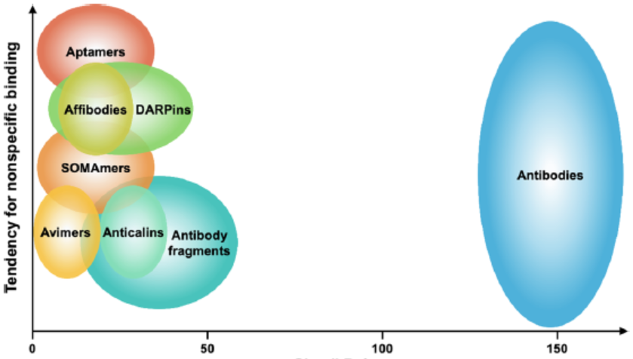
Biorecognition element engineering
Chem. Rev. 2021, 121, 8095−8160
Notes:
Larger and more sticky groups increase NSB
Affibody molecules are small, robust proteins engineered to bind to a large number of target proteins or peptides with high affinity, imitating monoclonal antibodies, and are therefore a member of the family of antibody mimetics. Affibody molecules are used in biochemical research and are being developed as potential new biopharmaceutical drugs
Affibody molecule was to apply a combinatorial protein engineering approach on a small and robust protein scaffold. The aim was to generate new binders capable of specific binding to different target proteins with almost good affinity, while retaining the favorable folding and stability properties, and ease of bacterial expression of the parent molecule.

Slide 3
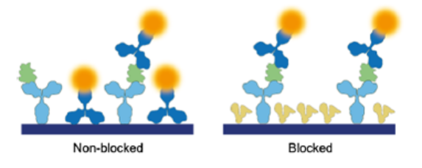
Blocking
Blocking is used to mask the free surfaces that would participate in non-specific binding
Blocking is typically achieved by incubating the functionalized surfaces with proteins
Blocking agents should have minimal reactivity with subsequent assay components, act as a stabilizer for biomolecules, exhibit low enzymatic activity, be reproducible
Common blocking agents for immunoassays: bovine serum albumin, lactalbumin, nonfat dry milk, whole normal (nonimmune) serum, and gelatin
Blocking agents bind more favrouably to the non-specific regions, outcompeting the antibodies
Chem. Rev. 2021, 121, 8095−8160

Slide 4
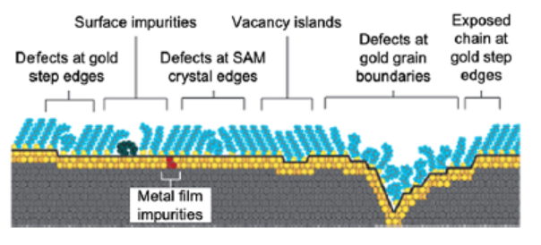
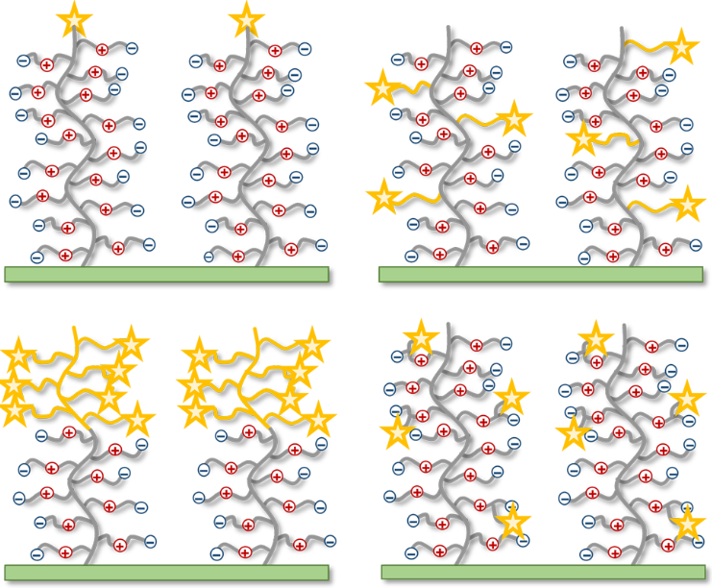
Surface Engineering
Depositing non-fouling or low-fouling layers to create an “inert surface”
Different types of polymers including polysaccharides (dextran), polyacrylates, polyacrylamides, and poly(ethylene glycol) (PEG)
The commonality of good anti-fouling surfaces is their capability in strongly binding water-polar, hydrogen bond accepting, not hydrogen bond donors, and electrically neutral
Self-assembled monolayers of ethylene glycols are commonly used to backfill the biosensor surface
Zwitterionic polymer brushes are emerging as antifouling coatings.
Langmuir 2019, 35, 1072−1084
Chem. Rev. 2021, 121, 8095−8160
Notes:
equal anion and cation groups on the molecular chains

Slide 5
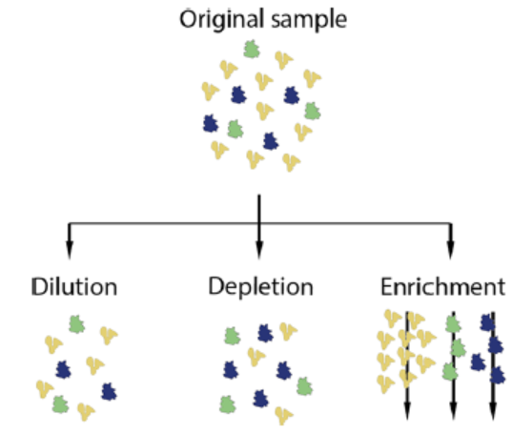
Sample treatment
Dilution reduces the concentration of the non-specific binders to below their Kd values but also reduces the concentration of specific binders
Depletion reduces the concentration of high abundance proteins-e.g. removing albumin and IgG that represent up to 90% of plasma proteins
Enrichment creates fractions of the sample where certain proteins of interest are corrected specifically
Notes:
Tag, amplify, filter
dilution lowers the concentration
of NSB molecules to significantly below their Kd, but it also
reduces the binding of the analyte of interest. Depletion reduces the
concentration of highly abundant proteins thereby reducing their NSB
without affecting the concentration of low abundant proteins.
Enrichment creates fractions of the sample where certain proteins of
interest are collected specifically.

Slide 6
Reducing the effect of NSB on the signal

Slide 7
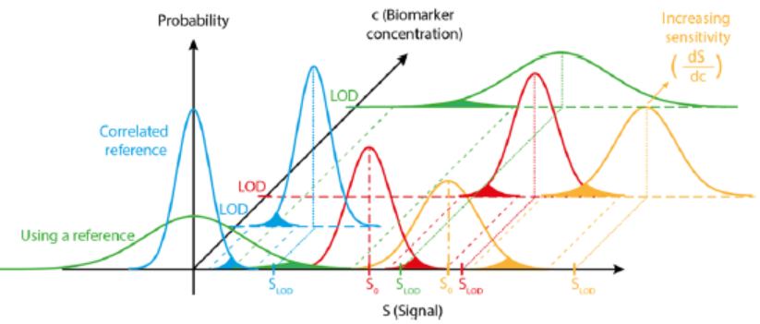
Why is reducing NSB important?
LOD is defined by the biomarker concentration at which the signal distribution will only have a X marginal overlap with the distribution corresponding to the zero analyte concentration
Chem. Rev. 2021, 121, 8095−8160

Slide 8
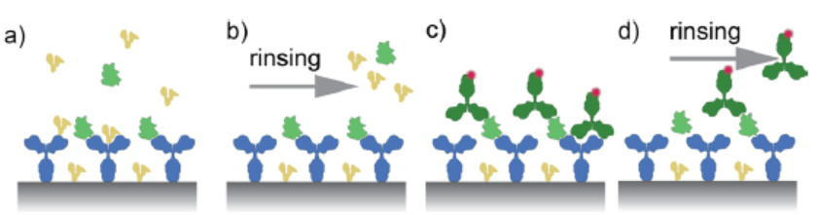
Discrimination by time-differences in off-rates
Despite the assay designer’s best efforts, NSB occurs
Washing can be used to release NSB without disrupting SB
The SB should have significantly slower off rates than NSB
The washing process can be slow (in the order of hours) due to the slow off rates of NSB
Chem. Rev. 2021, 121, 8095−8160

Slide 9
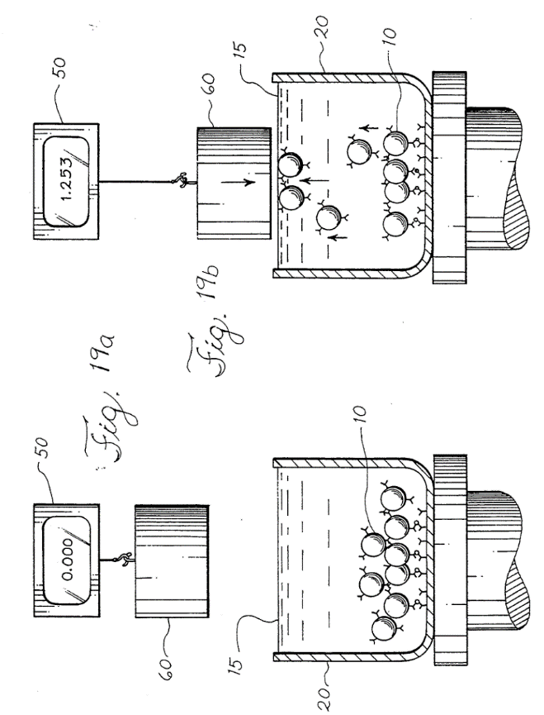
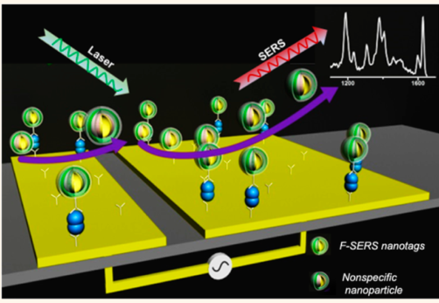
Discrimination by force
Magnetic force discrimination
Abbott laboratories
Electrohydrodynamic shear forces enable mixing and removal of non-specific species
Rohr, T. E. Magnetically assisted binding assays using magnetically-labeled binding members; 1995.
ACS Nano, 6354–6362,2015
Notes:
The application of an alternating potential difference across each asymmetric electrode pair results in a nonuniform field that is induced within the electrical double layer. The asymmetry in geometry results in a lateral variation in the number of charges and their spatial distribution across each electrode pair. As a result, nonuniform forces generated on the elec- trode surface facilitate net fluid flow with the lateral force on the larger electrode being stronger than that of the smaller electrode, thereby resulting in fluid flow toward the larger electrode. This resulting unidirec- tional fluid flow causes analytes in solution to be dragged by the flow and induces the necessary fluid mixing to enhance capture performance within the capture domain of the device.15 Meanwhile, these surface shear forces generated within nanometer dis- tances (e.g., λD = double-layer thickness = ∼34 nm, calculated for 1 mM phosphate buffer saline (PBS) using DebyeHückel approximation16) from the elec- trode surface and its associated fluid mixing can also displace weakly bound species, thereby resulting in specific target capture.

Slide 10
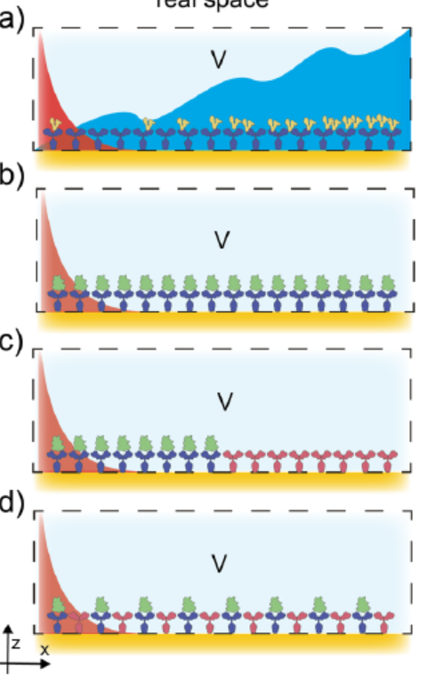
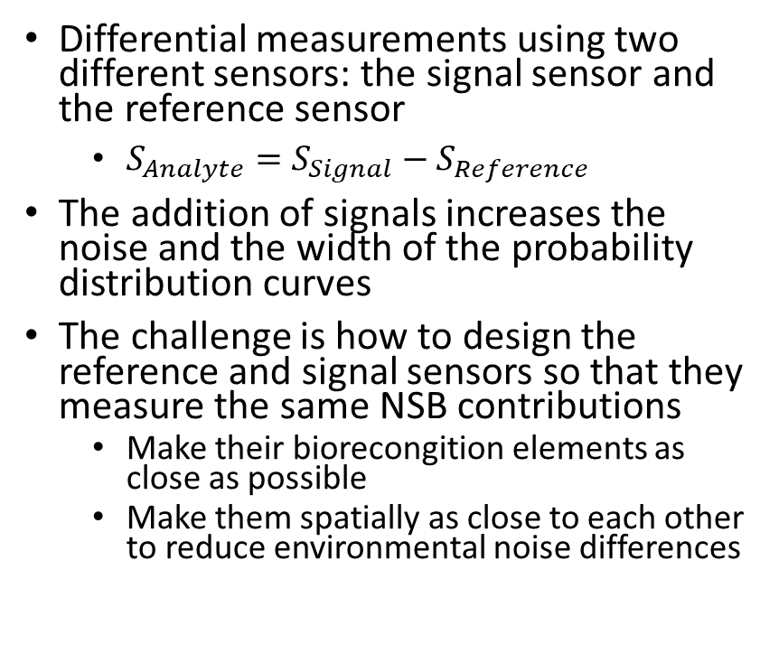
Discrimination by space
Differential measurements using two different sensors: the signal sensor and the reference sensor
$S_{Analyte}=S_{Signal}−S_{Reference}$
The addition of signals increases the noise and the width of the probability distribution curves
The challenge is how to design the reference and signal sensors so that they measure the same NSB contributions
Make their biorecongition elements as close as possible
Make them spatially as close to each other to reduce environmental noise differences
Chem. Rev. 2021, 121, 8095−8160

Slide 11
Conclusions
NSB determines the limit-of-detection of biosensors
NSB can occur by the binding of unwanted analytes to the biorecognition elements or the transducer surface
NSB can be reduced through sample processing, blocking and surface engineering
Following binding, NSB can be reduced by washing, force application, and referencing

